Slide 1
Introduction to Machine Learning

Slide 2
I am Tori Lazerson
I am a 4th year Bio-Engineering Major. I have been doing hydrogel research in Dr. Christman’s Lab since my freshman year! I have also done research on personalized cancer modeling systems at Lawrence Livermore National Laboratory and on Alzheimer’s Disease at the Buck Institute for Research on Aging. I am currently the Bioengineering Representative for Tau Beta Pi and a co-lead for a sensor project through the Quality of Life Plus Student Association!
Reach out to me on:
Linkedin: @www.linkedin.com/in/tori-lazerson
Message me on Facebook!

Slide 3

I am Ricky Martin
I am a Cognitive Science Machine Learning Major. I am a part of Mike Tolley’s Bio Inspired Robotics and Design lab on campus where I was tasked with creating a synthetic skin using Deep Learning models. My work on the synthetic skin was recently just put up for publication. From that very intense summer, many of my personal projects and now recently started job, as a data science intern at Go Site, has revolved around the field.
Reach out to me on:
Linkedin: @rickym7205
Or find me on Facebook

Slide 4
How is M.L. used?
Model is created
Basically creates a model like Y = m_{n}x_{n} + b
Weights (m,b) are randomized
Weights get adjusted given input = Learning
Gradient Descent
Model is applied
Apply model to app, situation, etc as long as data is similar in size (ways around this)
Model is improved
Keep improving model with new info

Slide 5
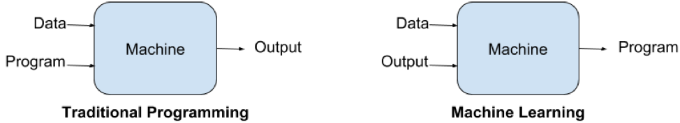
What is Machine Learning?
Traditional Coding Methods
In traditional Coding methods, we take data, apply rules to said data, code a ton, and get answers from this.
This is good for many simpler instances and is the way basically everything up to early 21st century was created.
Machine Learning
In M.L. methods, we take data, provide the output we expect, code a model, and get an algorithm out of this which allows us to arrive at our expected output with up to 99% accuracy.
This is good for new age tech and allowing machines to keep learning/AI.

Slide 6
What is M.L. used for?
Interact with everyday
Virtual Assistants
Commuting Predictions
Video Surveillance
Social Media
Email Filtering
Online support
Search Engine Results
Product recommendations
Smart Cars
Robotics
Specific Examples
Siri, Alexa, Cortana
Maps, Google maps
Jason Bourne tech is real
Recommendations, tags
Spam folder/suggested
Customer Service chat
Optimised Google results
Smart Ads/connected ads
Tesla, Google
Learning to walk, etc.

Slide 7
A.I. vs Data Science vs M.L.
Artificial Intelligence
Predict behavior in unprecedented ways.
Father idea of other two, uses different kinds of data to mimic human behavior/thought.
Can respond in unknown and creepy ways, huge emphasis on ethics due to this.
Think on its own.
Uses M.L. as a tool
Data Science
The use of data to create reports and dashboards to gain business insights.
Most input is generated as human consumable data, which is read and analyzed.
Requires knowledge in handling incoming unstructured data, structuring raw data, using statistical modeling.
Machine Learning
Access potential future scenarios by using advanced statistical methods.
Input for M.L. will be transformed to fit model parameters.
Can be very complex due to high level mathematics and algorithmic tuning.
Tool used in Data Science.

Slide 8
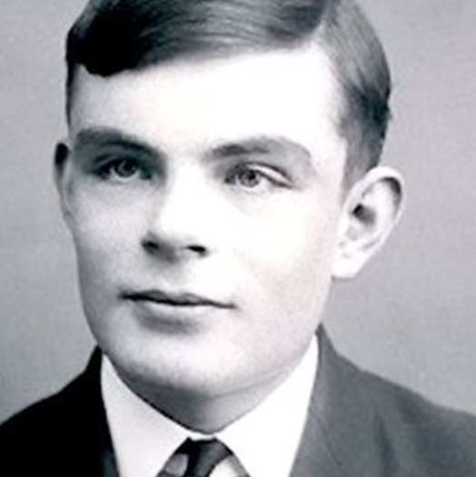
… What we want is a machine that can learn from experience, from past and present experience.
-Alan Turing 1947

Slide 9
Applications to Bioengineering
Virtual Histological Staining
Diagnosing Diabetic Retinopathy
Diagnosis of common lung diseases from chest radiography
Diagnosis of skin malignancies
Diagnose cancer from biopsy specimens
https://www.nature.com/articles/s41551-018-0305-z

Slide 10
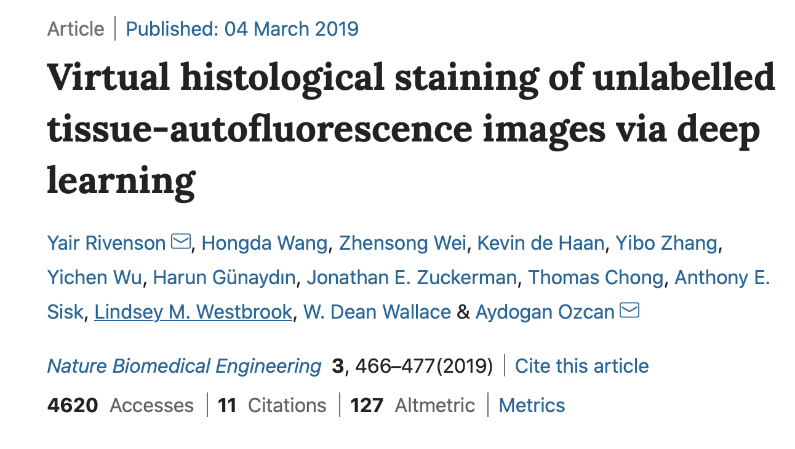
Virtual Histological Staining
“The virtual-staining method bypasses the typically labour-intensive and costly histological staining procedures, and could be used as a blueprint for the virtual staining of tissue images acquired with other label-free imaging modalities.”

Slide 11
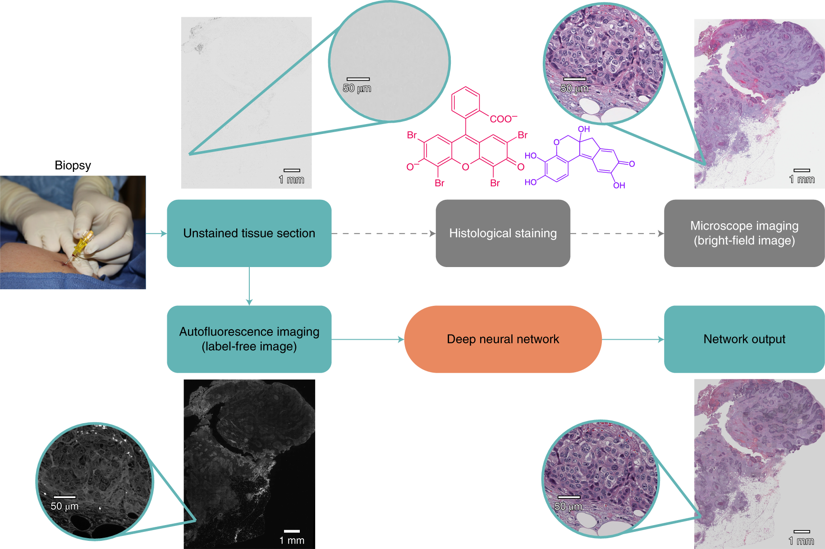
Rivenson, Y., Wang, H., Wei, Z. et al. Virtual histological staining of unlabelled tissue-autofluorescence images via deep learning. Nat Biomed Eng 3, 466–477 (2019) doi:10.1038/s41551-019-0362-y

Slide 12
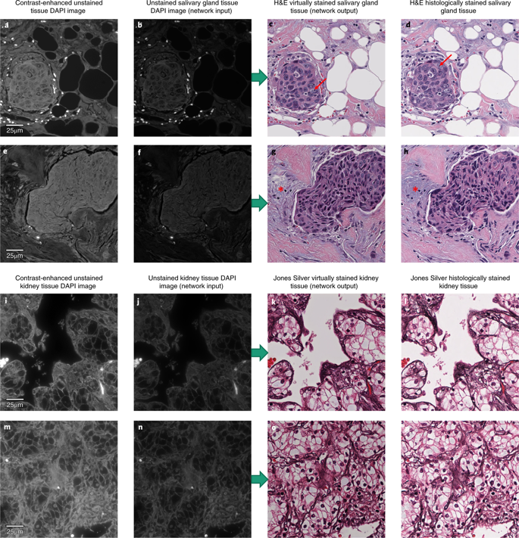
Rivenson, Y., Wang, H., Wei, Z. et al. Virtual histological staining of unlabelled tissue-autofluorescence images via deep learning. Nat Biomed Eng 3, 466–477 (2019) doi:10.1038/s41551-019-0362-y

Slide 13
Why it matters
Staining is a commonly used tool in disease diagnosis and biological research
Current gold standard: fix and embed tissue sample, section, stain, and image
Requires multiple reagents
Irreversibly changes the tissue
Virtual staining saves time and money by bypassing the entire staining process
Tissue samples can be saved and used for additional analysis
Rivenson, Y., Wang, H., Wei, Z. et al. Virtual histological staining of unlabelled tissue-autofluorescence images via deep learning. Nat Biomed Eng 3, 466–477 (2019) doi:10.1038/s41551-019-0362-y

Slide 14
What kinds of M.L. is there?
Discussing the three main M.L. methods:
Supervised Learning
Unsupervised Learning
Deep Learning

Slide 15
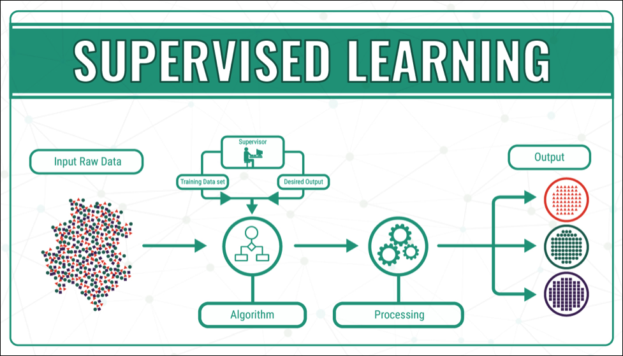
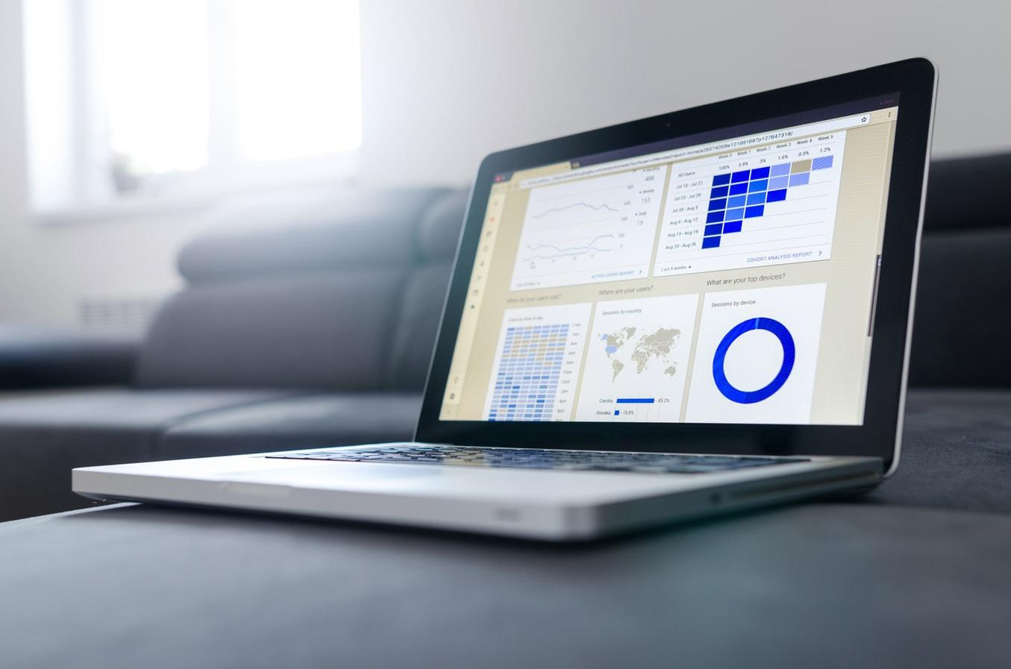
Supervised Learning
Refers to methods used where by the result/outcome of the inputs is known in advance. Running these types of methods will result in models tailored specifically to the given data. Outside data will result in outputs that the model learned to associate/relate to the given inputs with.

Slide 16
Type of Supervised Models
Classification:
K-Nearest Neighbor (K-NN)
Support Vector Machine (SVM)
Kernel SVM
Naive Bayes
Decision Tree Classification
Random Forest Classification
Logistic Regression
Used in:
Identity Fraud Detection
Image Classification
Customer Retention
Diagnostics
etc.
Regression:
Used in:
Advertising/popularity prediction
Weather Forecasting
Market Forecasting
Estimation of life Expectancy
Population Growth Predictions
etc.
Simple Linear Regression
Multiple Linear Regression
Polynomial Regression
Ridge/Lasso Regression
Support Vector Regression
Decision Tree Regression
Random Forest Regression

Slide 17
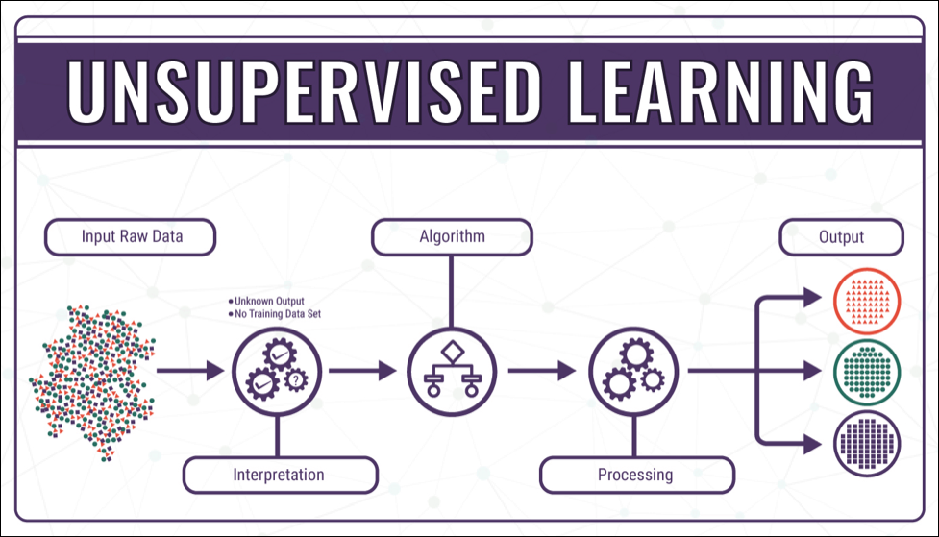
Unsupervised Learning
Refers to methods used where by the result/outcome of the inputs is not know in advance. Running these types of methods will result in patterns emerging and models inferencing what is believed to be similar info. Outside data given to these models will result in similar pattern or classifications being displayed.

Slide 18
Type of Unsupervised Models
Clustering:
Used in:
Recommender Systems
Targeted Marketing
Customer Segmentation
etc.
K-Means Clustering
Hierarchical Clustering
Agglomerative
Mean-Shift
Fuzzy C-Means
Dimensionality Reduction:
Used in:
Big Data Visualization
Meaningful Compression
Structure Discovery
Feature Elicitation
etc.
t-SNE
PCA
LSA
SVD
LDA
Association Rule Learning:
Used in:
Pattern Recognition
Rule Learning
etc.
Euclat
Apriori
FP-Growth

Slide 19
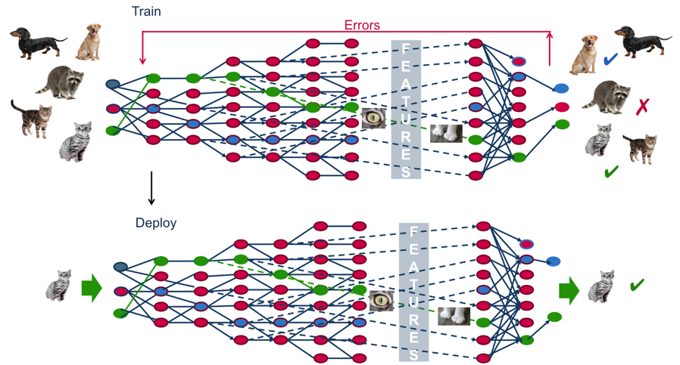
Deep Learning
Most advanced form of Machine Learning. Models can learn through both supervised or unsupervised data, sometimes even both. Biggest difference is the ability to learn from past behavior (back propagation) and apply more or less importance (weight change) to specific inputs, leading to a “smarter” outcome.
Takes way longer usually.

Slide 20
Type of Deep Learning Models
Reinforcement Learning:
Used in:
Video Game
Virtual Assistants
Learning Tasks
etc.
Genetic Algorithm
A3C
SARSA
Q-Learning
Deep Q-Network (DQN)
Artificial Neural Networks:
Used in:
Learning Tasks (action based)
Real Time Decision making
Robot Navigation
Robotic Movement, ex learning how to walk through simulation
Skill Acquisition
A.I.
Main Computer Learning
Anything “Smart”, IOT
Recommendation Systems
etc.
Convolutional Neural Networks (CNN)
DCNN
Recurrent Neural Networks (RNN)
LSM
LSTM
GRU
Generative Adversarial Networks (GAN)
Time Series GAN
Autoencoders
Perceptrons (MLP)

Slide 21

This all sounds great, but how does it all work?
Machine Learning can be summarized into 8 steps.

Slide 22
Step 1:
Gathering Data
1
The 8 steps to Machine Learning

Slide 23
Step 1: Gathering Data
Since the entirety of Machine Learning is based off of Data, this step is extremely important and critical to your success in machine learning.
This data will also determine how well your model performs in getting the results you envision.
Data can be gathered in a multitude of ways, many databases have huge sets of data that you can look at and use, however in most machine learning position you may have to create your own data or use previously created data.
if this is the case ensure it is properly labeled

Slide 24
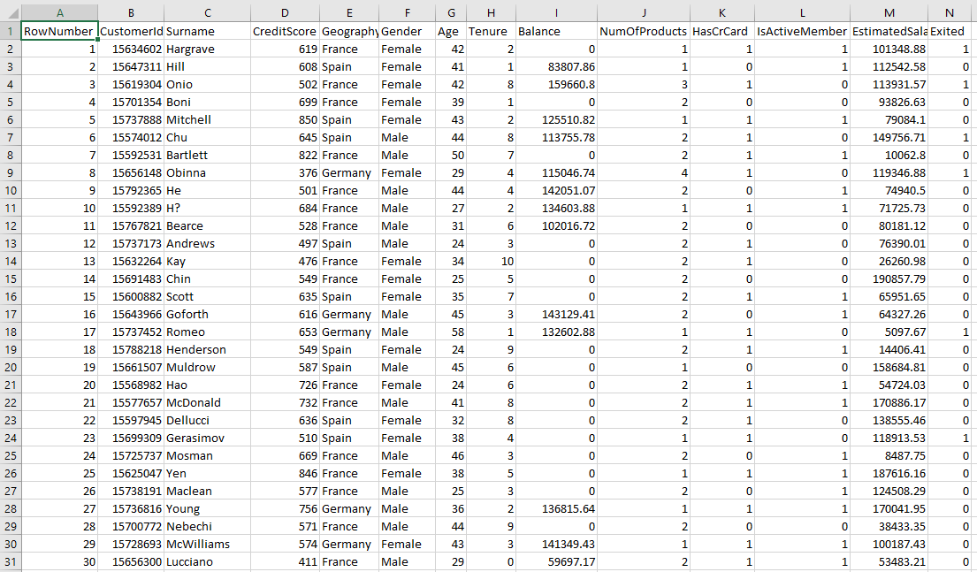

Slide 25
Step 2:
Data Preparation
2
The 8 steps to Machine Learning

Slide 26
Step 2: Data Preparation
After gathering data you want to fix it up and turn it into the perfect data for your machine.
This is perhaps the longest and most tedious task of machine learning because models can be very picky.
Get rid of or fill in null data/change data if need be.
Normalization, encoding, duplication, etc.
At times randomize data to ensure there is no bias data.
Turn it into the proper file/size
Csv, json, etc.
Simple data vs. higher dimensional data
Split Data 80% train, 20% evaluate/test

Slide 27
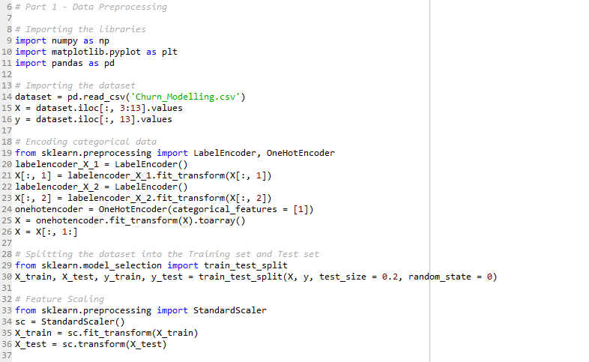

Slide 28
Step 3:
Choosing a Model
3
The 8 steps to Machine Learning

Slide 29
Step 3: Choosing a model
Right before this step it is a good idea to plot/visualize your data to ensure you completely understand it.
This will also showcase any data imbalances.
Graphing also important in choosing model.
A lot of research is needed at this step. With tensorflow and keras it is now easier than ever to call upon a model library to complete your tasks, but knowing what methods to use is extremely important.
Research different methods, internet is an amazing source in helping you choose a model.

Slide 30
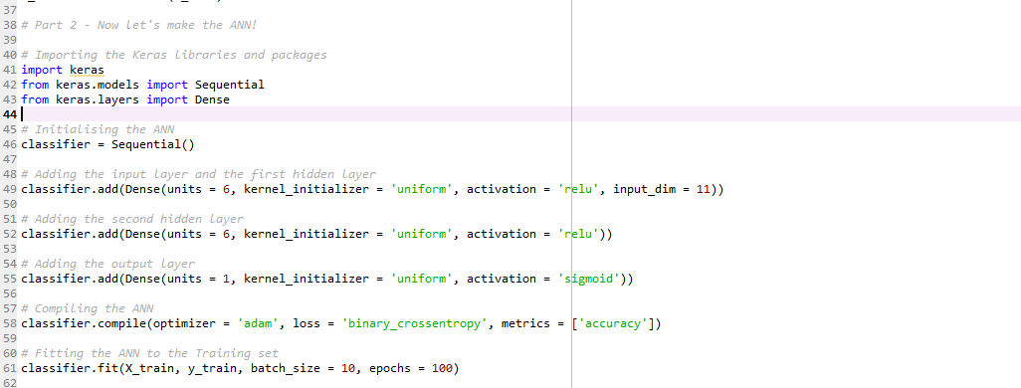

Slide 31
Step 4:
Training
4
The 8 steps to Machine Learning

Slide 32
Step 4: Training
Use our data to incrementally check and adjust our algorithm = prediction
This can be thought of like driving a car:
Unsupervised: Randomly push knobs figuring out what each thing does to learn what does what and use that to move the car and learn that way, as time goes by.
Supervised: told what is go/stop and we need to learn how to use these in tandem to enable us to drive so we utilize this knowledge to infer best ways to drive.
Deep Learning: Weather we know What is what or not when we start, we are constantly test ourselves. If we do something good we are rewarded, but if we mess up we get punished.

Slide 33
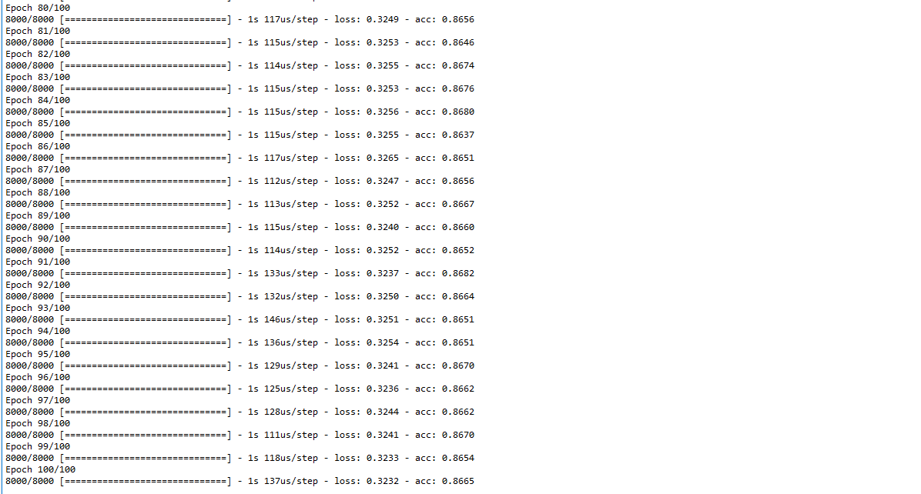

Slide 34
Step 5:
Evaluation
5
The 8 steps to Machine Learning

Slide 35
Step 5: Evaluation
See if model is any good.
Test the model on the 20% you set aside earlier
This data was never used to train model so it should be completely unknown to the system turning the testing. Run inputs through system and compare y_predicted, with the actual y value.
Also keep in mind that most models (good models) will display accuracy so you can track how accurate you model.
95 % usually sweet spot, 10/10
Anything over is not always a good thing

Slide 36
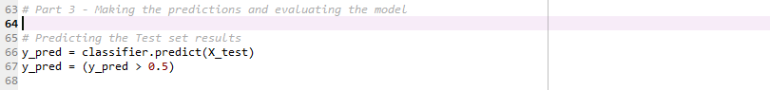
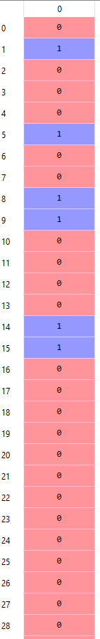
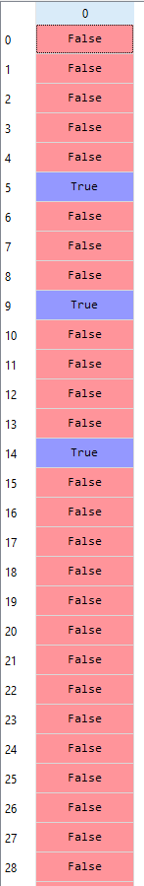
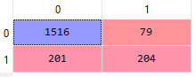

Slide 37
Step 6:
Parameter Tuning
6
The 8 steps to Machine Learning

Slide 38
Step 6: Parameter Tuning
Fix parameters in order to better your model to get the accuracy you are after.
This is important because sometimes accuracy for certain parameters can result in 75% accuracy and lead you to believe your data/work is not good. Many times this is not the case, there are alot of factors that go into making a model good so testing parameters can turn that 75% into a 90% quite easily.
Adjust epoch, learning rate, initialized values, etc.
Find out what is important to you, kind of an art.

Slide 39
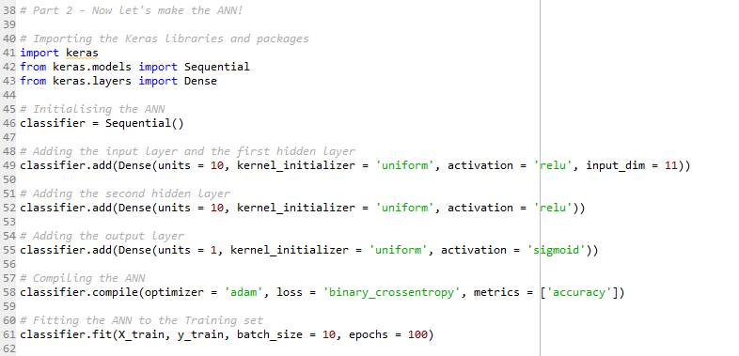

Slide 40
Step 7:
Prediction
7
The 8 steps to Machine Learning

Slide 41
Step 7: Prediction
Now that you have your model it is time to make predictions or test it with other data to see if the model is the best it can be or you should try other methods.
This step is usually followed by cleaning everything up in your code and testing the model over an over.
Also be sure to confirm that the accuracy is in fact accurate, especially given live data. This gets very messy very often.

Slide 42
Step 8:
Implementation
8
The 8 steps to Machine Learning

Slide 43
Step 8: Implementation
Now that you have a working model let your Entrepreneurial side take flight and truly explore what you can achieve with this technology.
Even examples as simple as the ones we will show, showcase the stepping stones to way more complex task.
Example: Learning how to sort Apples by color (very easy) is a direct tool used by smart cars to allow driverless cars to detect stop signs and know when the light is green, yellow, or red.

Slide 44
How to succeed in M.L.
Learn and have a good understanding of:
Python or R, better yet both
SQL if you plan to get Data from internet
Excel and google sheets
Mathematical Skills, statistics
TensorFlow, what google is doing
Data wrangling/manipulation
Python Libraries such as:
Numpy, matplotlib, Pandas, Scikit-Learn, Theano, Keras, sklearn, etc.

Slide 45
THANKS!
Any questions?

Slide 46
Learning More
Ted Talks:
https://www.ted.com/talks/jeremy_howard_the_wonderful_and_terrifying_implications_of_computers_that_can_learn
https://www.ted.com/talks/blaise_aguera_y_arcas_how_computers_are_learning_to_be_creative
https://www.ted.com/talks/anthony_goldbloom_the_jobs_we_ll_lose_to_machines_and_the_ones_we_won_t
Good Resources to Start Learning
https://elitedatascience.com/learn-machine-learning#extras
https://www.coursera.org/learn/machine-learning
https://www.udemy.com/course/machinelearning/
https://www.kaggle.com/learn/machine-learning-explainability
https://towardsdatascience.com/best-resources-for-ai-machine-learning-data-science-d72625d4689d
https://developers.google.com/machine-learning/problem-framing/
https://stanford-cs221.github.io/autumn2019/
https://learn.saylor.org/course/view.php?id=96
https://www.udacity.com/course/intro-to-artificial-intelligence--cs271
http://ai.berkeley.edu/lecture_videos.html
https://www.edx.org/course/artificial-intelligence-ai
https://ocw.mit.edu/courses/electrical-engineering-and-computer-science/6-034-artificial-intelligence-fall-2010/
https://www.reddit.com/r/MachineLearning/
Notes:
Special thanks to all the people who made and released these awesome resources for free:
Presentation template by SlidesCarnival
Illustrations by Sergei Tikhonov
Photographs by Unsplash

